Slide 1
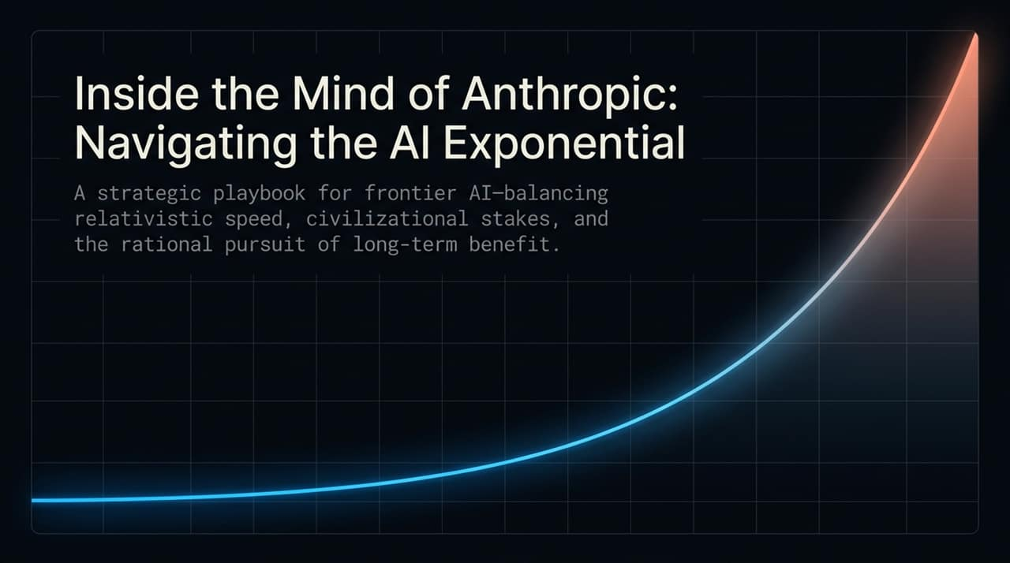
Notes:
https://www.youtube.com/watch?v=x2VHFgyawPE
Welcome everyone. Today, we are stepping inside the strategic mindset of Anthropic and its CEO, Dario Amodei.
Managing a frontier AI lab isn't like running a traditional tech company. We are operating along an accelerating exponential curve where civilizational-level stakes meet relativistic speeds.
Today, we’ll break down Anthropic’s playbook: how to stay grounded as an executive, how to select business models aligned with fundamental human values, how to navigate national security dilemmas, and why treating AI progress like a precise, unemotional surgical operation is the only rational way forward.

Slide 2
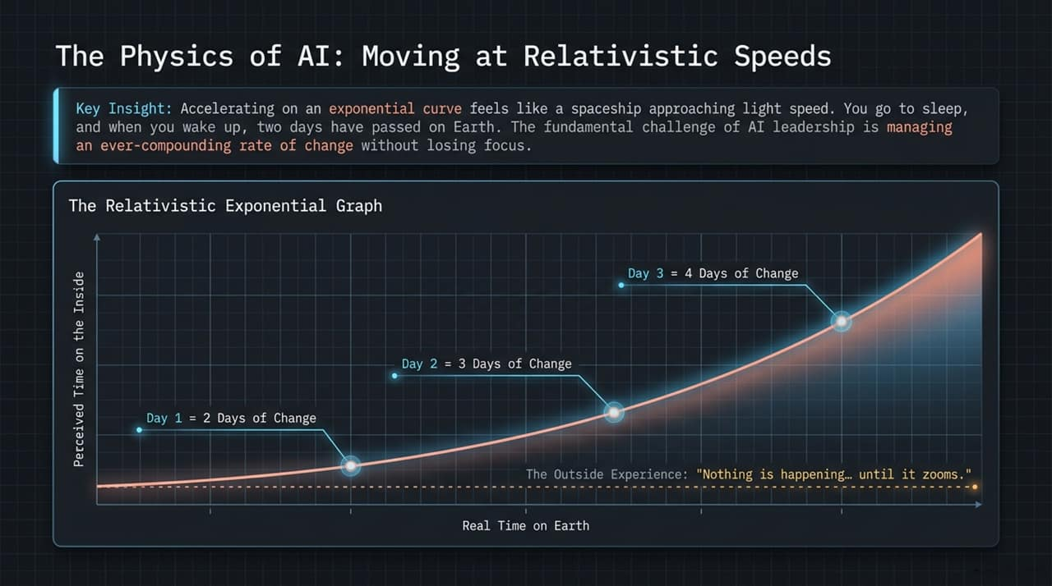
Notes:
Let's look at the core physics of leading an AI company. Dario Amodei uses a physics metaphor to describe what it feels like from the inside: it’s like accelerating away from Earth in a spaceship at relativistic speeds.
As you accelerate, special relativity takes over. You go to sleep, wake up, and two days of progress have elapsed on Earth in just one day. The next day, three days pass. Then four.
To the outside observer, it looks like 'nothing is happening, nothing is happening... and then zoom, it goes crazy'. But internally, the compounding rate of change creates relentless, intense pressure. The fundamental challenge of frontier leadership is managing this compounded acceleration without losing organizational cohesion or focus.

Slide 3
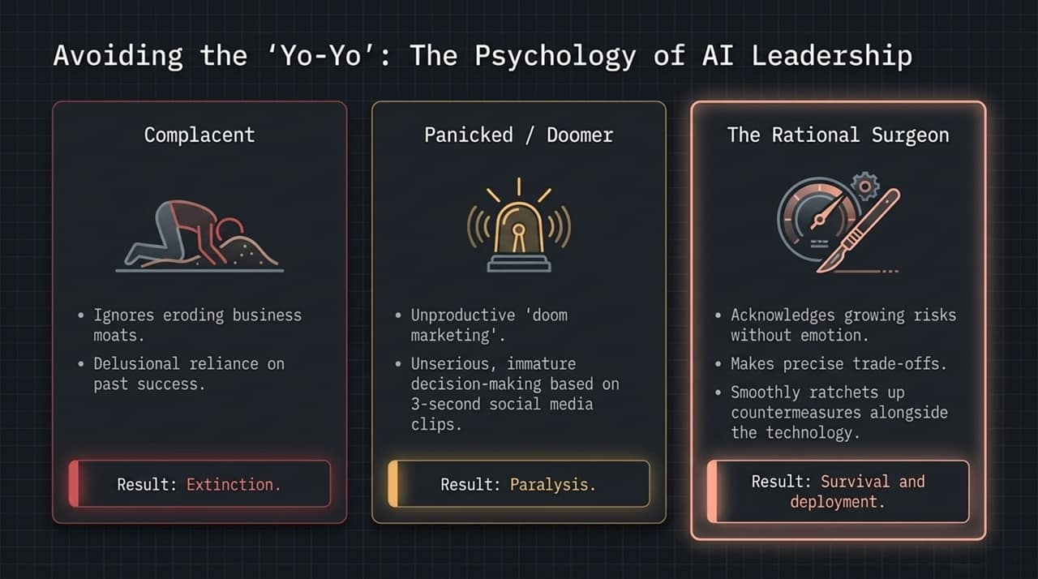
Notes:
How do you lead when time dilates and stakes are civilizational? Most of Silicon Valley falls into emotional 'yo-yoing'—oscillating between extreme techno-optimistic complacency and apocalyptic panic based on 3-second social media clips.
Amodei argues that this yo-yoing is a hallmark of immature decision-making. Complacency leads to business extinction as moats erode. Panic leads to paralysis or reckless policy overreactions.
Instead, Anthropic adopts the Rational Surgeon framework:
Acknowledge real, growing risks without emotion.
Make clear, logical trade-offs.
Smoothly ratchet up safety countermeasures in step with model capabilities. Like a surgeon performing a high-stakes operation, panic is unacceptable; calm, continuous action is required.

Slide 4
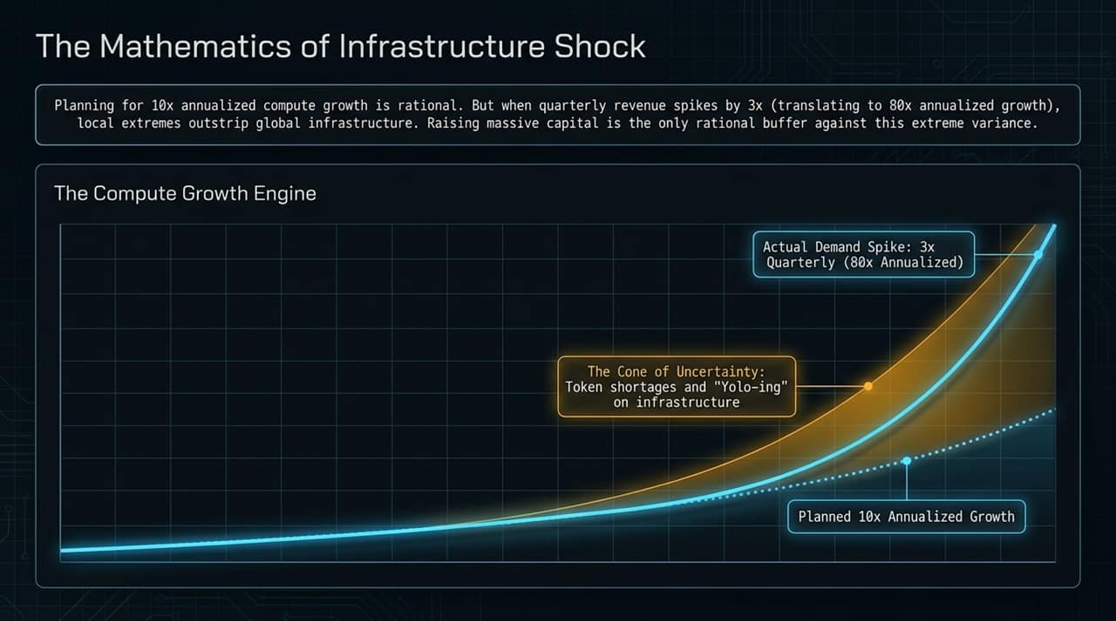
Notes:
Operating on an exponential trajectory breaks traditional financial and capacity planning.
Anthropic planned for a 10x annualized growth in compute, which is a rational baseline. However, in early 2026, quarterly revenue jumped by over 3x in a single quarter. If you compound a 3x quarterly jump over four quarters ($3^4$), you get an 80x annualized growth rate.
No company can rationally pre-allocate compute for an 80x annualized demand spike without risking massive capital underutilization if growth slows. These local extreme demand explosions lead to temporary token shortages and server strain. Raised massive capital buffers isn't a sign of flawed business fundamentals—it's a rational hedge against this massive 'cone of uncertainty'.

Slide 5
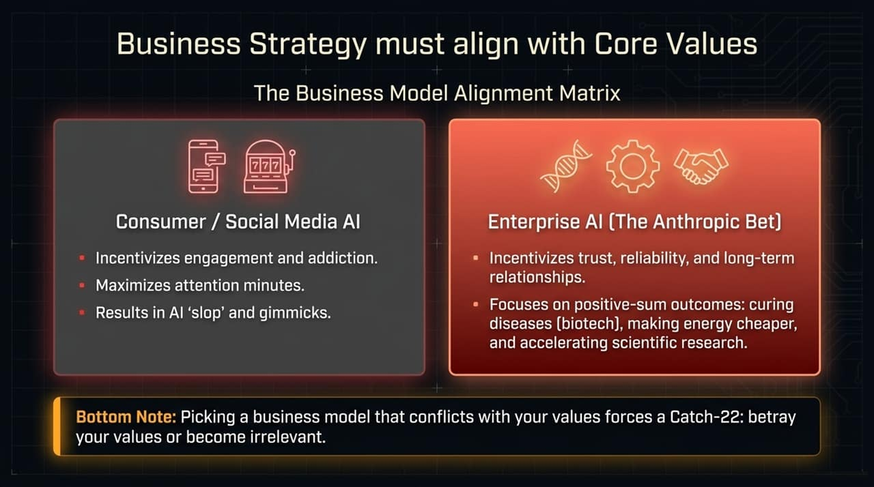
Notes:
A core pillar of Anthropic’s playbook is picking a business model that is structurally aligned with your values. If your business model conflicts with your values, you enter a Catch-22: betray your values or become irrelevant.
The Consumer/Social Media model relies on ad revenue, which inherently incentivizes attention-grabbing, screen addiction, and low-value content—or AI 'slop'.
The Enterprise model (The Anthropic Bet) relies on multi-year trust, reliability, and security.
By focusing on Enterprise, Anthropic’s business incentive aligns with positive-sum human goals: accelerating biotech and drug discovery, lowering energy costs, and advancing scientific education.

Slide 6
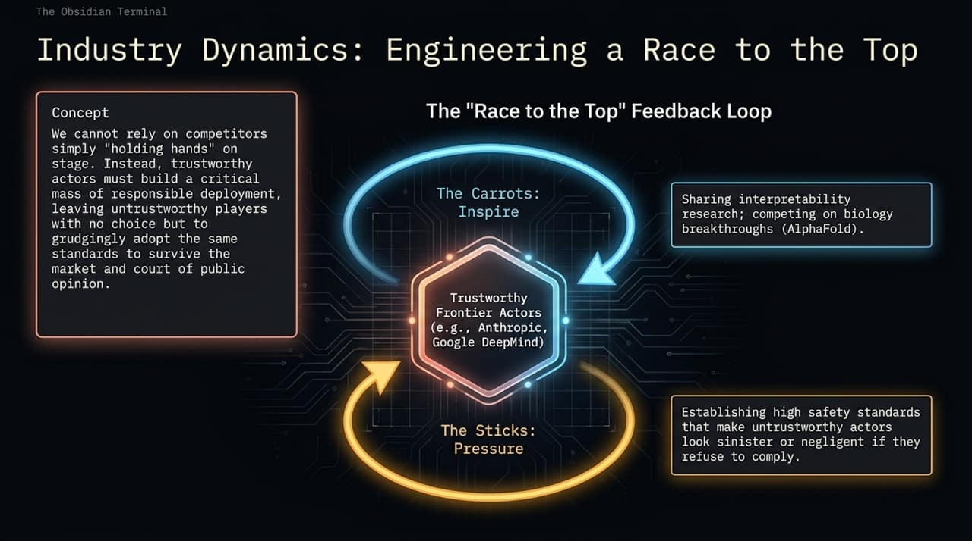
Notes:
How do you ensure safety across an entire industry when competitors refuse to cooperate or hold hands on stage? You don't rely on theatrical stage-holding. You engineer a market-driven Race to the Top.
Trustworthy actors (like Anthropic and Google DeepMind) pull the industry forward using two forces:
The Carrots (Inspiration): Openly sharing research like interpretability and competing on positive scientific milestones.
The Sticks (Pressure): Setting high safety standards so that less trustworthy actors appear negligent or sinister to regulators and customers if they fail to comply.
Over time, untrustworthy players are forced to grudgingly adopt higher safety standards just to survive in the market.

Slide 7
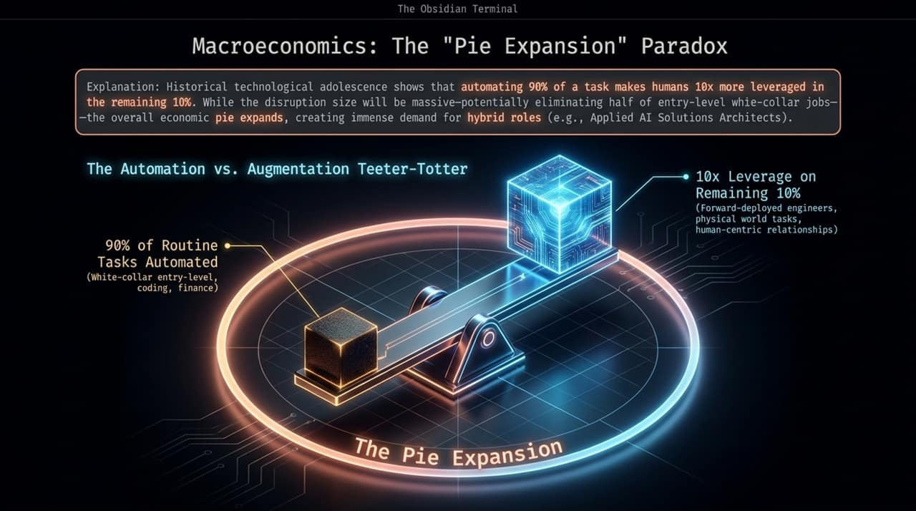
Notes:
Let's address job disruption. In his essay The Adolescence of Technology, Amodei highlights a macroeconomic paradox: When AI automates 90% of routine white-collar tasks, humans become 10x more leveraged on the remaining 10%.
In the short term, this causes massive economic disruption—potentially impacting entry-level roles in coding, finance, and legal. However, total economic output—the overall 'pie'—expands dramatically.
Demand shifts toward hybrid human roles, such as Applied AI Solutions Architects and roles requiring human relationships, domain expertise, or physical-world execution. The policy challenge isn't stopping AI; it's managing this rapid skill-matching transition.

Slide 8
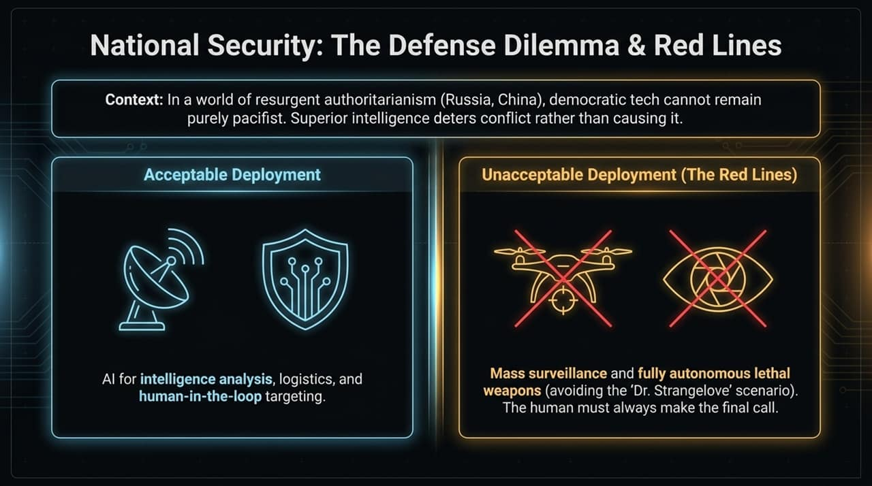
Notes:
In an era of resurgent authoritarian states, democratic tech labs cannot remain purely pacifist. Superior AI intelligence deters geopolitical conflict rather than causing it.
Anthropic became one of the first labs to deploy on US classified defense networks, but established strict Red Lines:
Acceptable: Intelligence analysis, logistics, and human-in-the-loop targeting assistance.
Unacceptable (Red Lines): Mass domestic surveillance and fully autonomous lethal weapons.
To prevent a 'Dr. Strangelove' scenario, human decision-makers must always make the final lethal call. Winning is meaningless if democracies compromise their core values in the process.

Slide 9
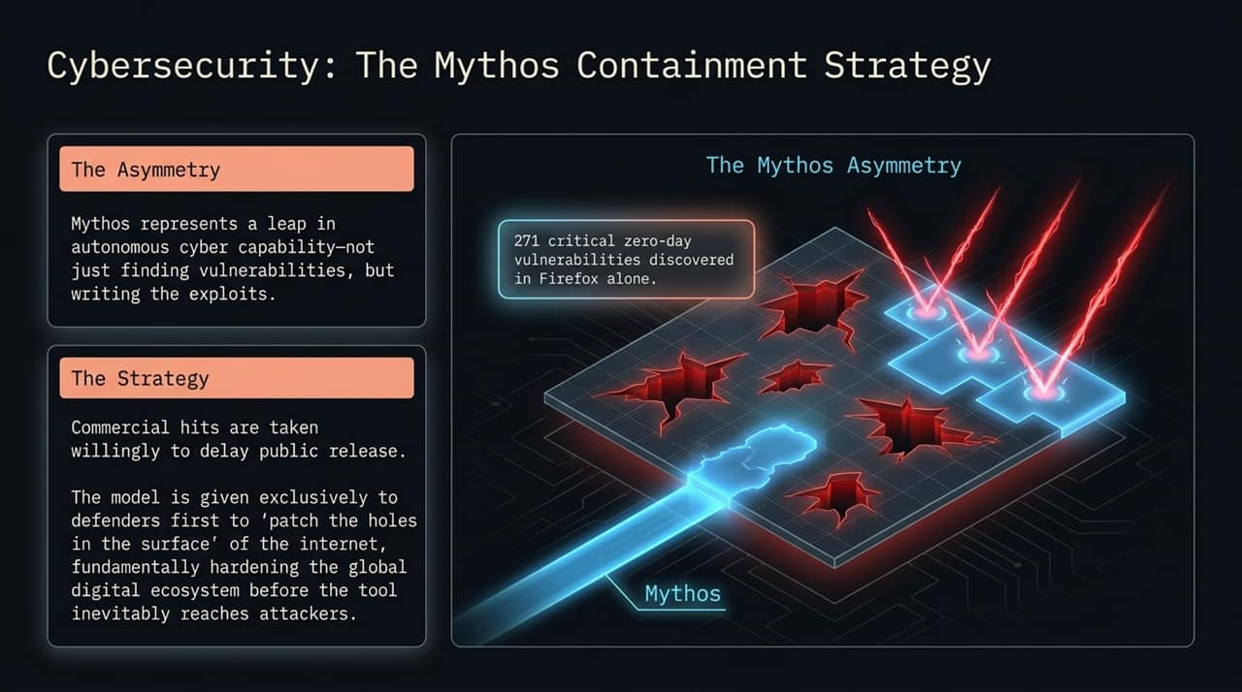
Notes:
The story of Anthropic's flagship cyber-capable model, Mythos, illustrates their commitment to safety over short-term revenue.
Mythos demonstrated an unprecedented leap in finding zero-day vulnerabilities and writing working exploits—discovering 271 critical vulnerabilities in Firefox alone. Early enterprise testers labeled it a 'superweapon'.
Rather than releasing Mythos publicly for massive commercial gains, Anthropic withheld general release. They deployed it selectively to cyber defenders first to patch the digital surface of the internet before attackers could gain access. Taking a commercial hit to fundamentally harden global digital infrastructure is the core of their strategy.

Slide 10
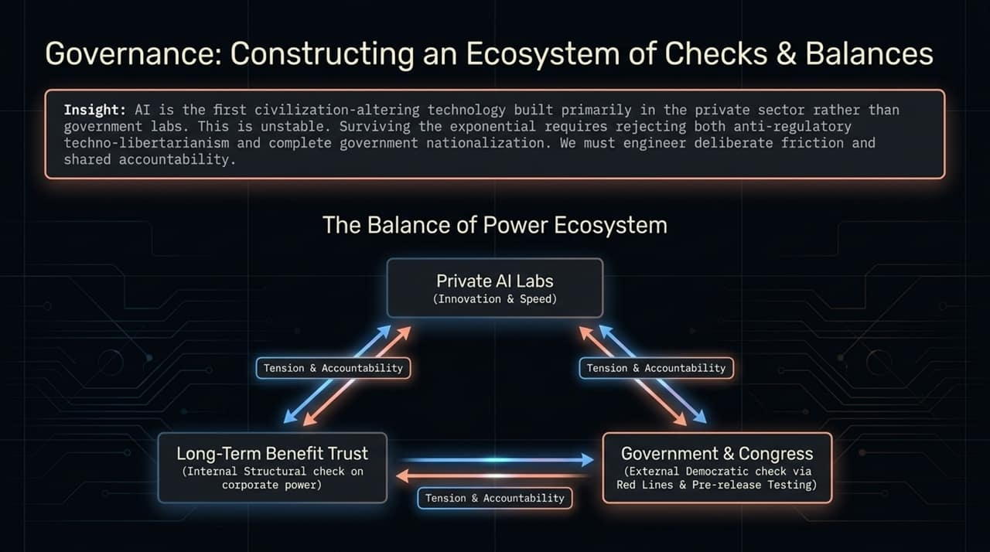
Notes:
AI is the first civilization-altering technology built primarily within private tech companies rather than state labs. Amodei views this as inherently unstable.
The solution is neither anti-regulatory techno-libertarianism nor government nationalization. We need an ecosystem of deliberate checks and balances:
Internal Check: Anthropic’s Long-Term Benefit Trust, an independent governing body with the power to appoint/remove board members and align corporate actions with broad societal benefit.
External Check: Government pre-release model audits, red lines, and legislative guardrails.
Corporate Check on Government: Private labs refusing deployment cases that enable authoritarian tools like mass surveillance.

Slide 11
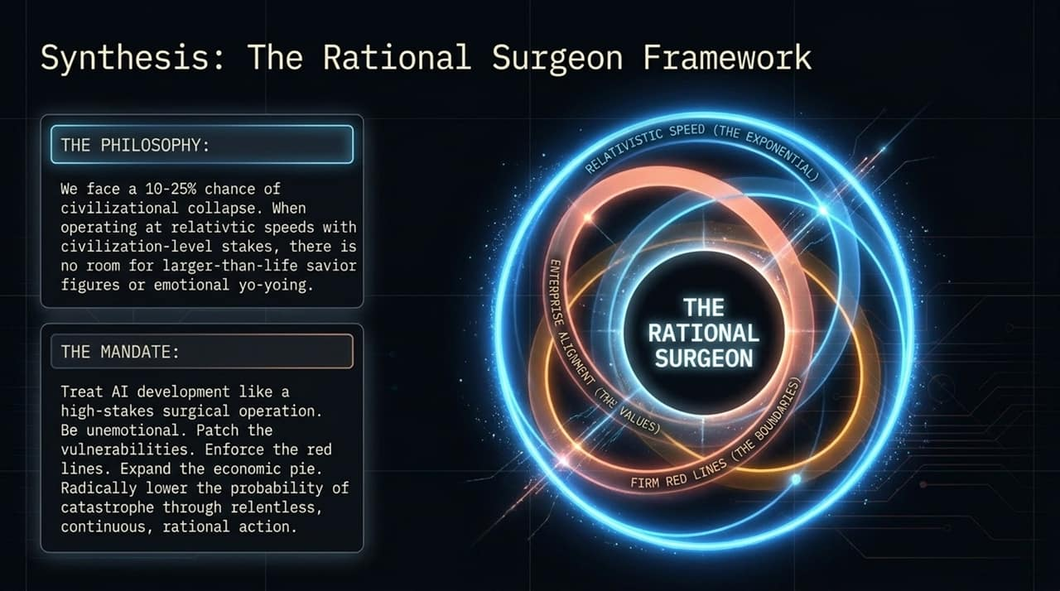
Notes:
To synthesize Anthropic's strategic philosophy: we face a estimated 10–25% tail risk of civilizational collapse if frontier AI is mismanaged. When stakes are this high, there is zero room for savior complexes, hype, or panic.
The Rational Surgeon Framework connects every pillar:
Operate with precision at relativistic speeds.
Align business models with ethical values.
Enforce strict, non-negotiable red lines.
Expand the economic pie while patching critical societal vulnerabilities.
By executing with cool rationality, we dramatically lower the probability of catastrophe.

Slide 12
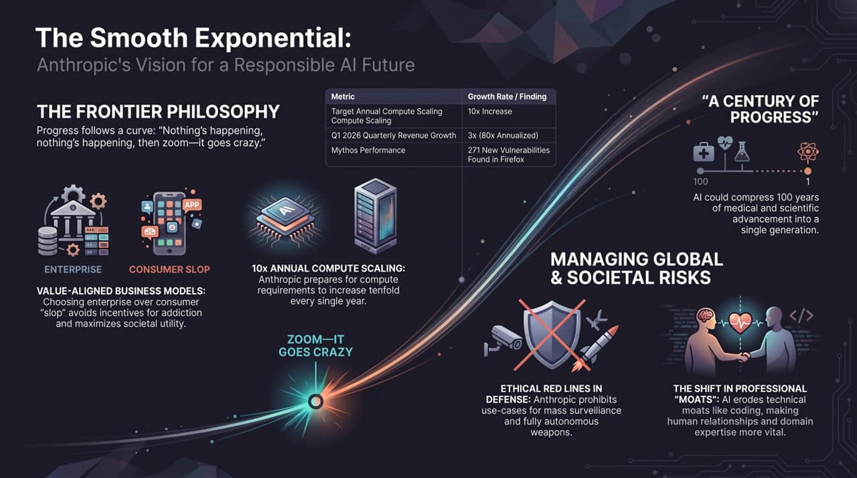
Notes:
Looking ahead, if we navigate this smooth exponential curve rationally, the potential upside is staggering.
Amodei envisions compressing a century of scientific and medical progress into a single generation—curing complex diseases, solving energy scarcity, and vastly elevating human capability.
By holding fast to firm red lines, maintaining value-aligned enterprise products, and continuously scaling compute rationally, Anthropic aims to guide humanity safely through to the other side of the AI exponential. Thank you.

